Slide 1
Thinking in Graphs
John Lambert, @JohnLaTwC
Microsoft Threat Intelligence Center

Slide 2
Welcome!

Slide 3
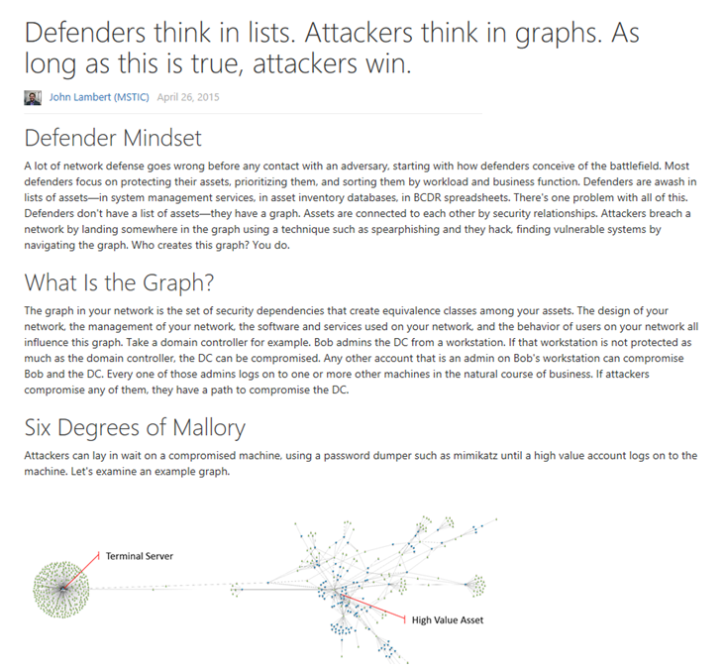
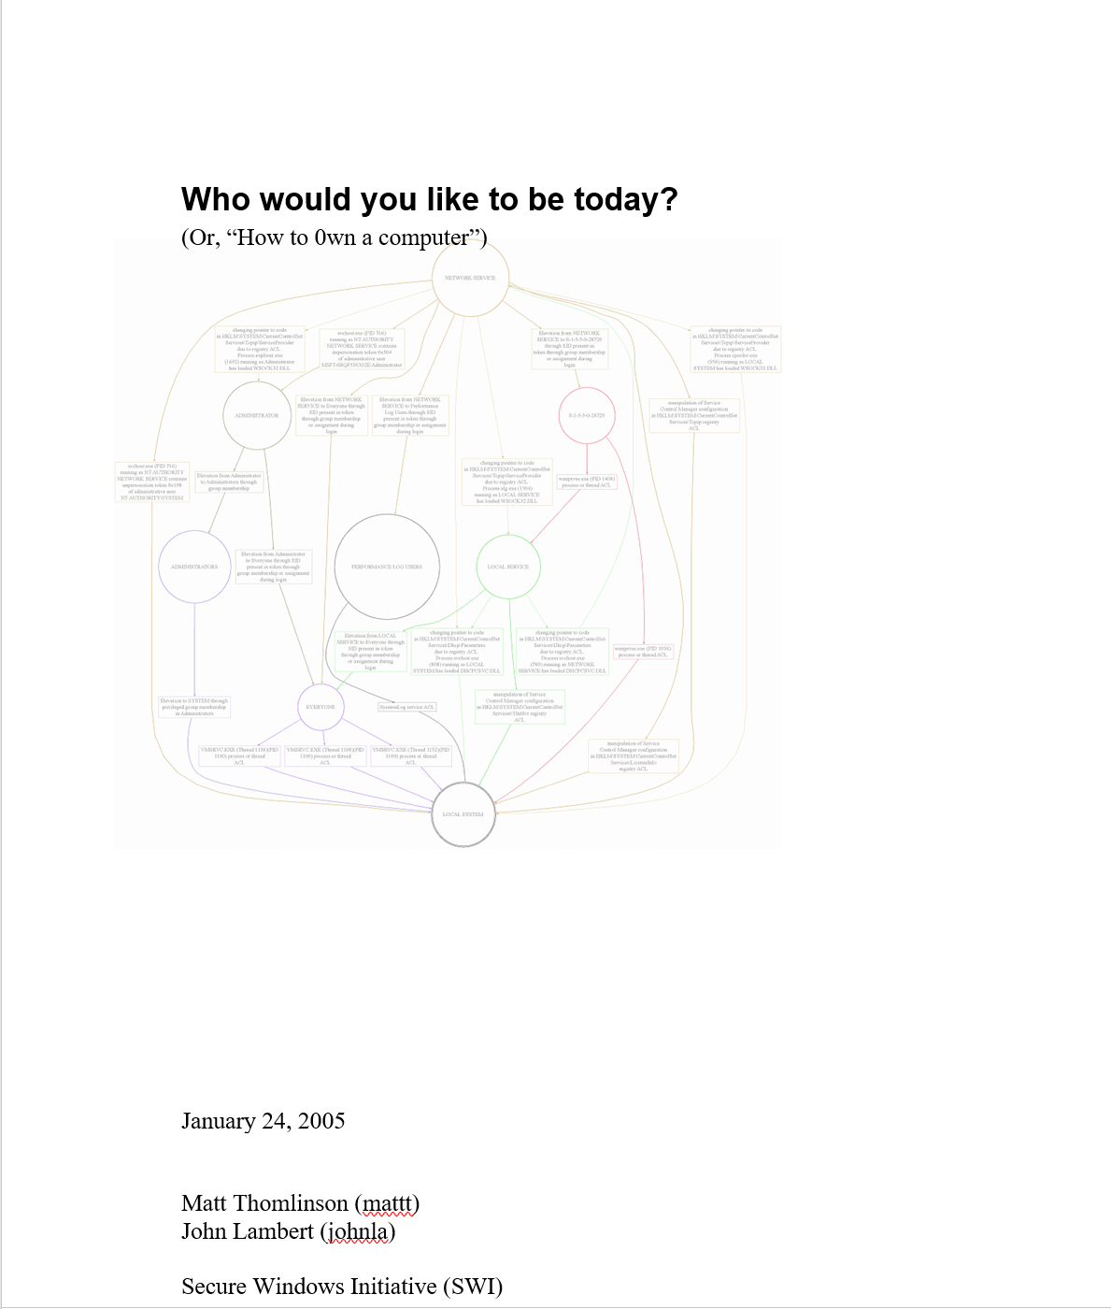
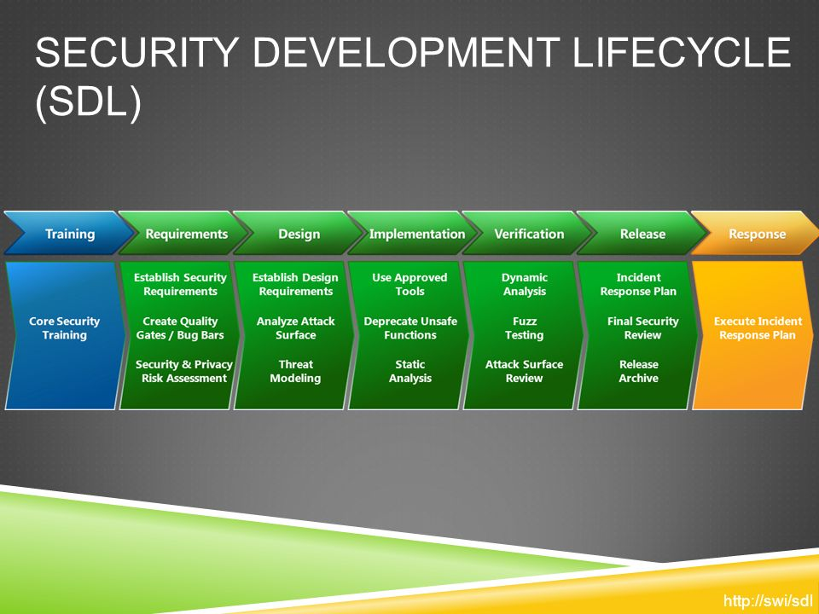
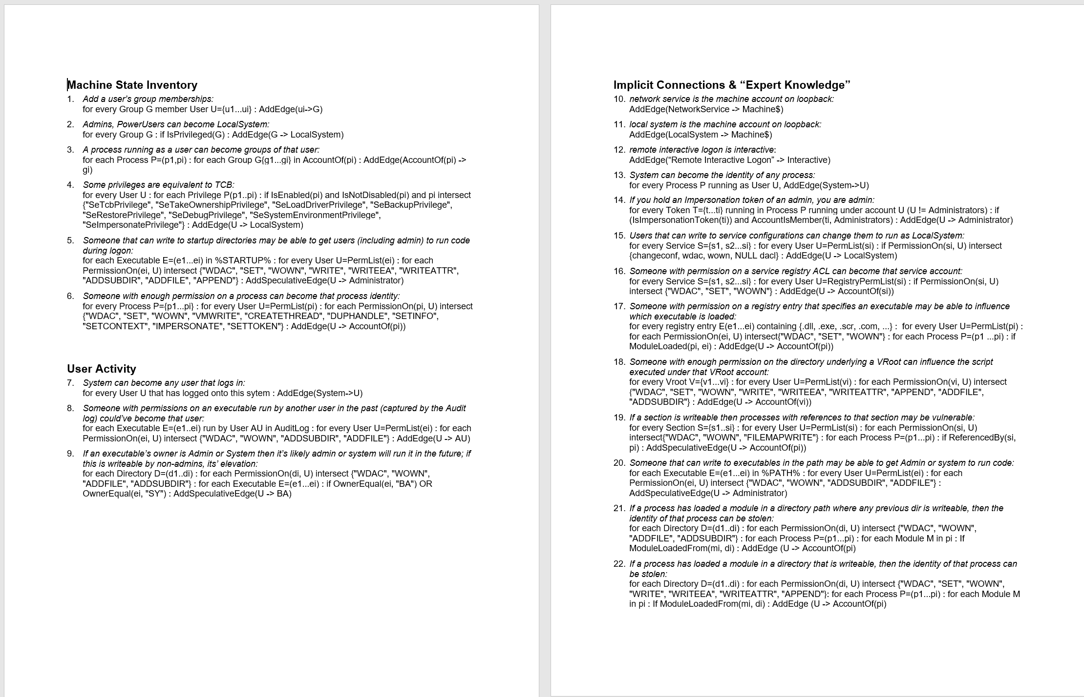
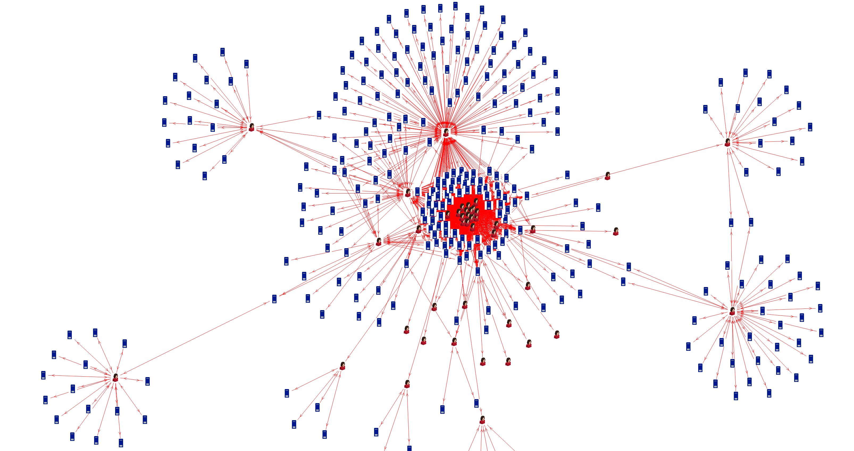
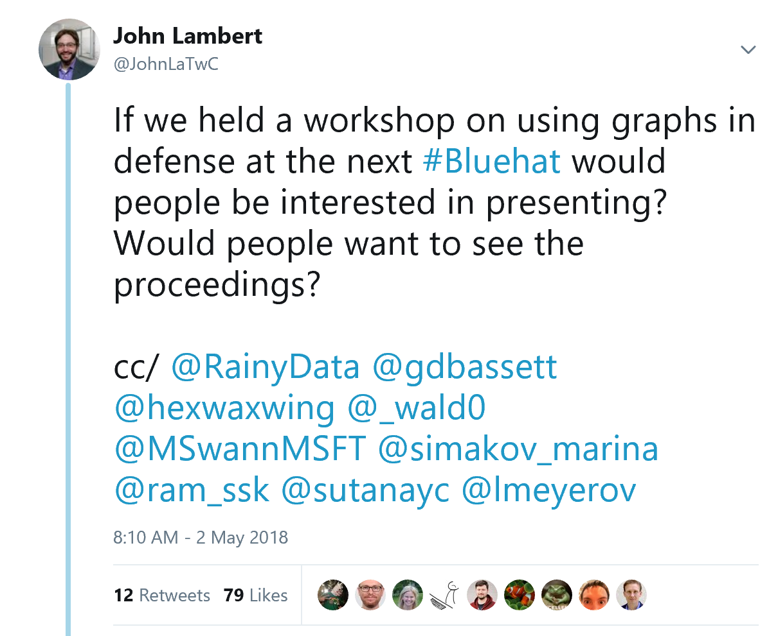
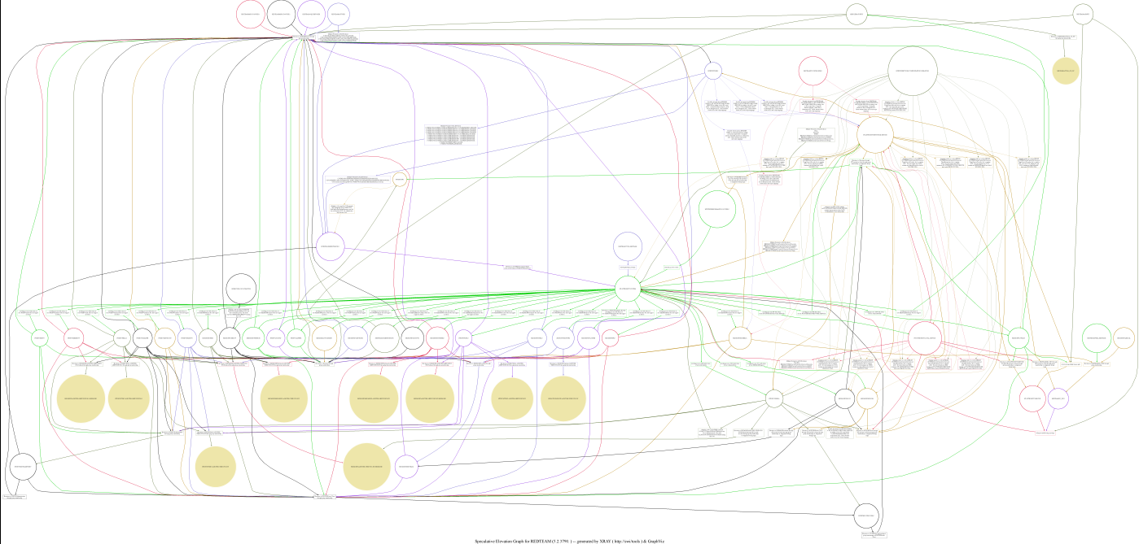
Why are we here?

Slide 4
Time travel back to 2005

Slide 5
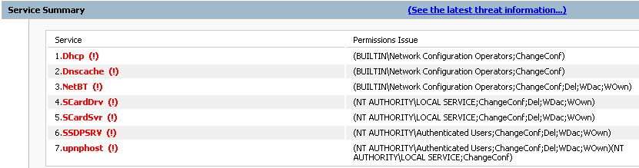
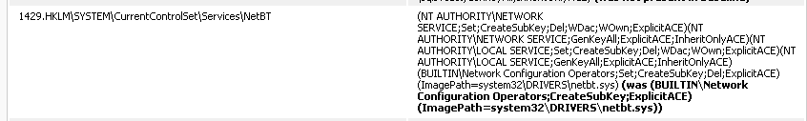
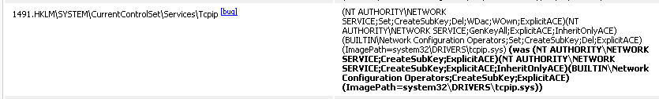
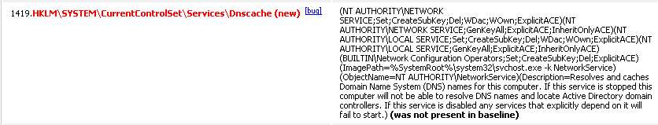
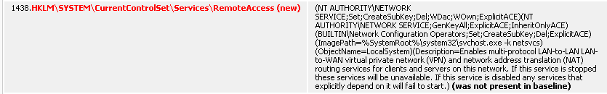
Started noticing things…

Slide 6

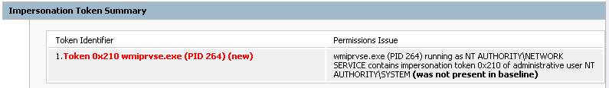




Noticed More…

Slide 7
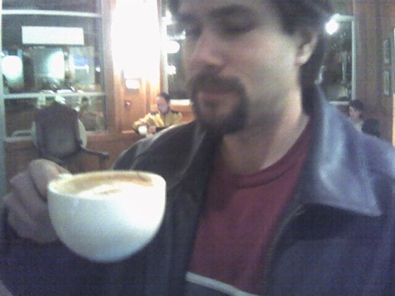

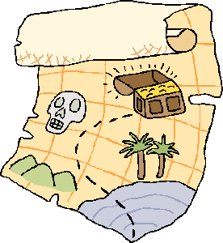
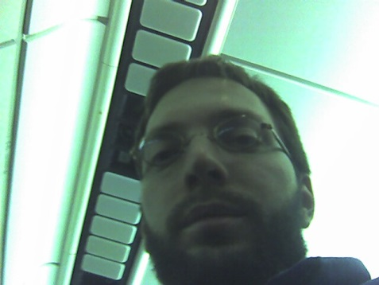
Search for Elevations!
During one of our annual "hackweeks¹" MattT and I wondered if we could piece together micro-elevations to find full pathways
r00t!
With NT
Technology
+
+
=
¹ Imagine a Thinkweek + compiler :-)

Slide 8
Search for Elevations!
During one of our annual "hackweeks¹" MattT and I wondered if we could piece together micro-elevations to find full pathways
Identify Edges
analsvcact |  | sqlwriter.exe ACL |  | sqlsvcacct
sqlsvcacct |  | SeTcbPrivilege |  | LOCAL SYSTEM
Everyone |  | CSAVCHK.exe ACL |  | NTDEV\JohnLa
NTDEV\JohnLa |  | Group |  | Net Cfg Operator
Net Cfg Operator |  | DHCP ACL |  | LOCAL SYSTEM
because of
can become
because of
can become
because of
can become
because of
can become
because of
can become
Build Graph
Go Find LOCAL SYSTEM!
¹ Imagine a Thinkweek + compiler :-)

Slide 9
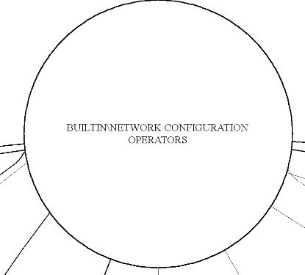
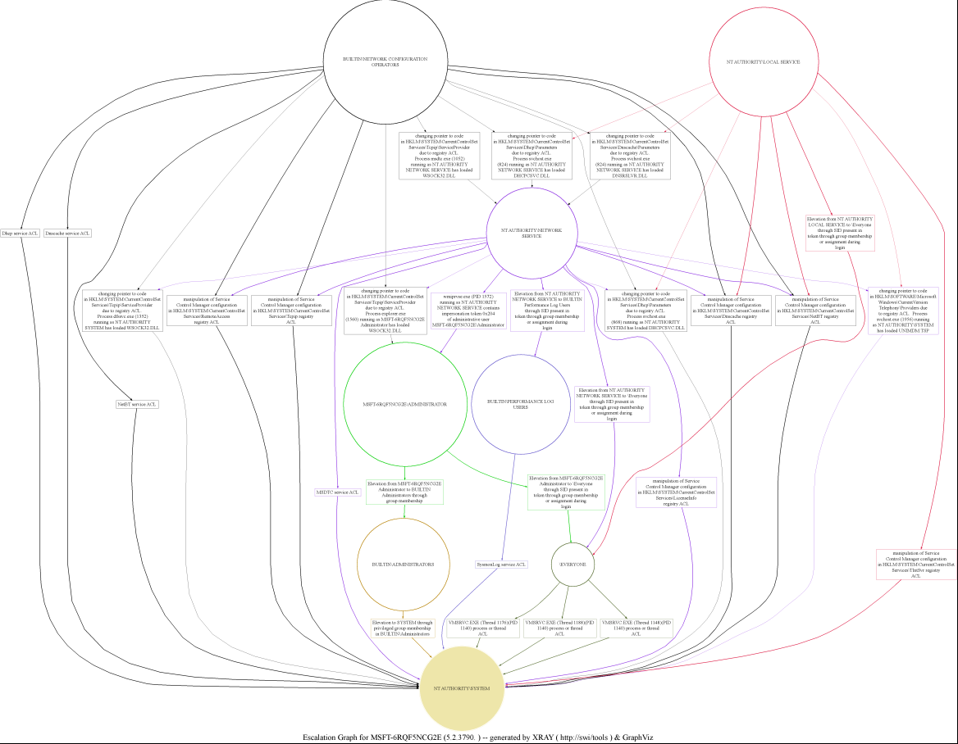
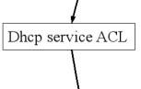
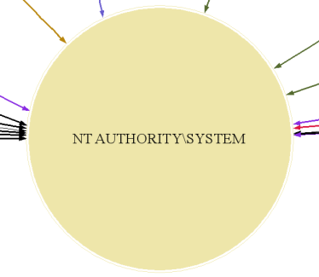
Elevation Graph for WS03 RTM

Slide 10
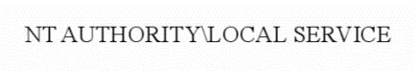
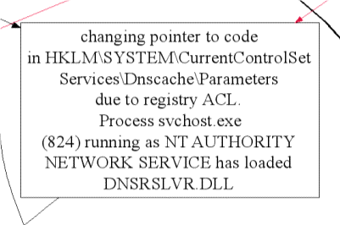
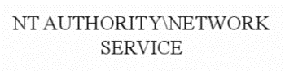
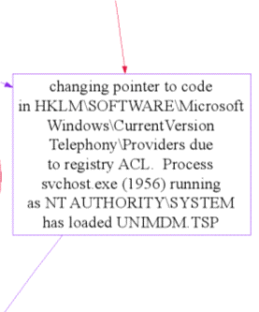
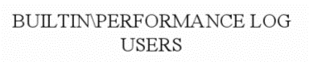
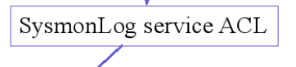
Elevation Graph for WS03 RTM

Slide 11


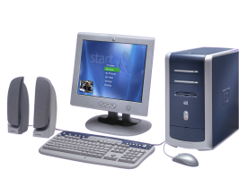
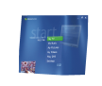

How do we take over a domain controller?
Weak passwords
Missing Patches
Misconfiguration
Weak passwords
Missing Patches
Misconfiguration
Weak passwords
Missing Patches
Misconfiguration
Weak passwords
Missing Patches
Misconfiguration
Admin #4, #5, #6
Print Server
Updates
SMS
AV
Weak passwords
Missing Patches
Misconfiguration
Weak passwords
Missing Patches
Misconfiguration
Weak passwords
Missing Patches
Misconfiguration
Monitoring
Workstation
Domain Controller
Weak passwords
Missing Patches
Misconfiguration
Where do they log in?
Login scripts
Admin
#1
#2
#3
Weak passwords
Missing Patches
Misconfiguration
Weak passwords
Missing Patches
Misconfiguration
Weak passwords
Missing Patches
Misconfiguration
Lobby Kiosk

Slide 12
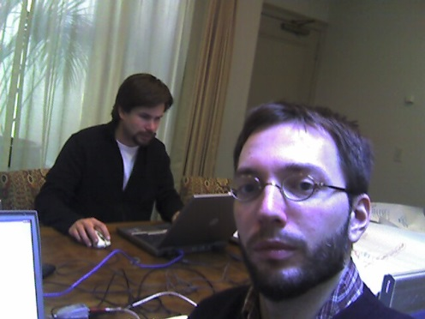

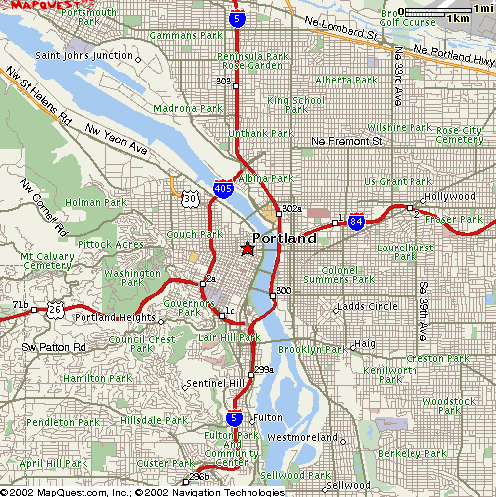

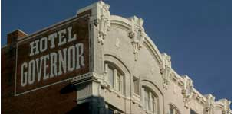
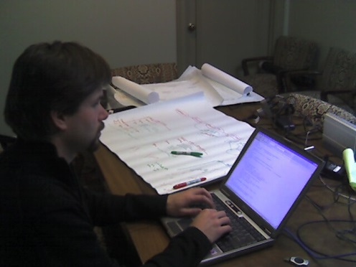
Search for Elevations on the Network!
MattT and I took another Hackweek™ and applied this approach to XRAY—combine single machine elevations to attack the network
r00t!
r00t!
r00t!
r00t!
+
+
=
r00t!
r00t!
¹ Imagine a Thinkweek + compiler :-)

Slide 13
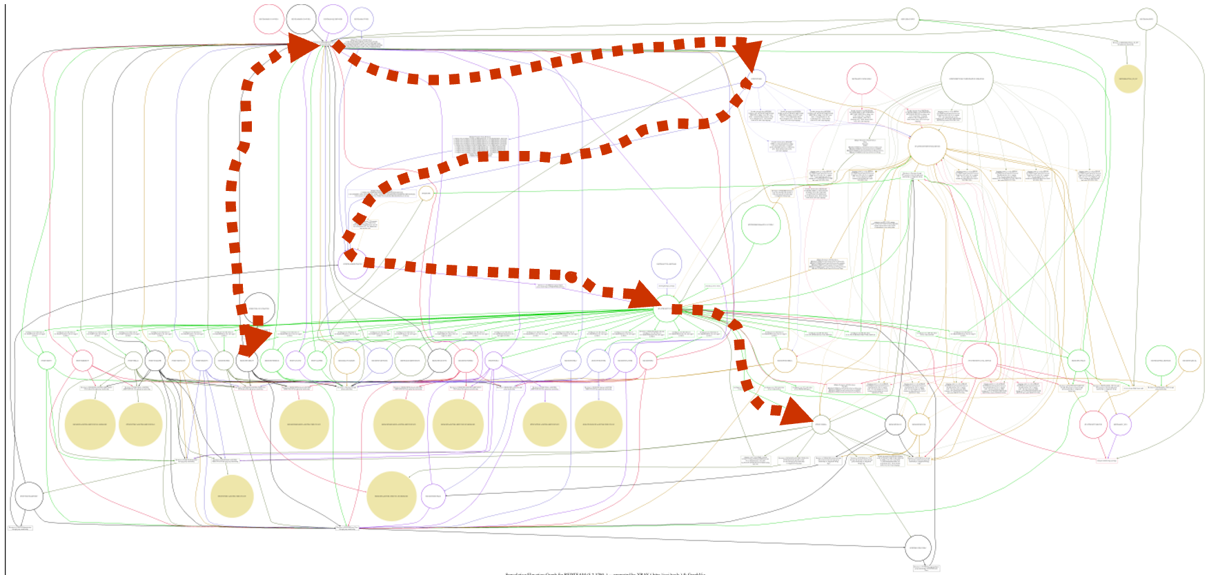
Local and Network Compromise Together
Now go attack the network with our compromised account!

Slide 14
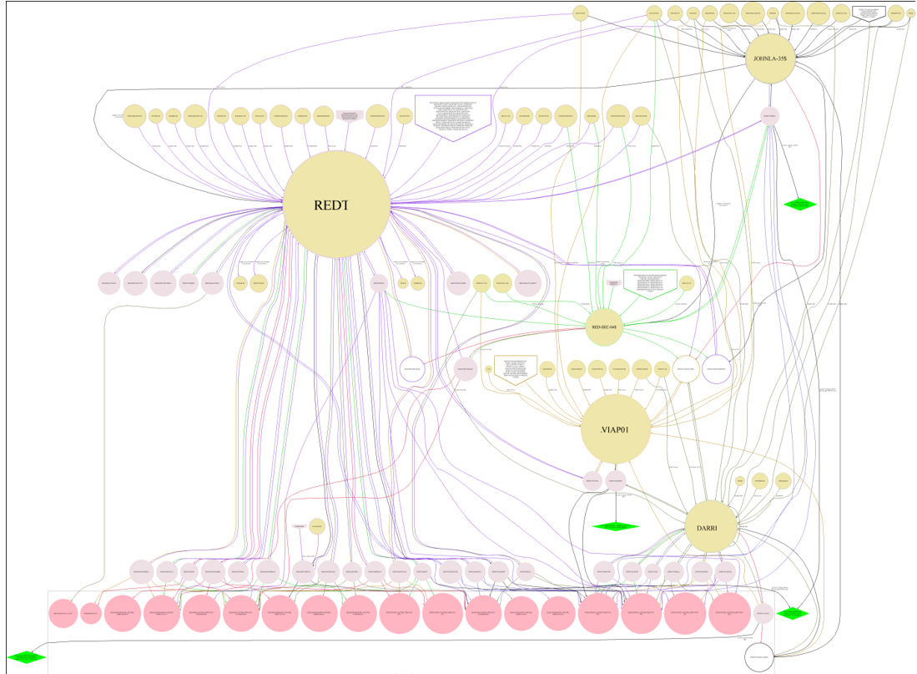
Local and Network Compromise Together
Join elevation graphs across machines in the network

Slide 15
What about application attack surfaces? Extending X-Ray to SQL Databases

Slide 16
Before

Slide 17
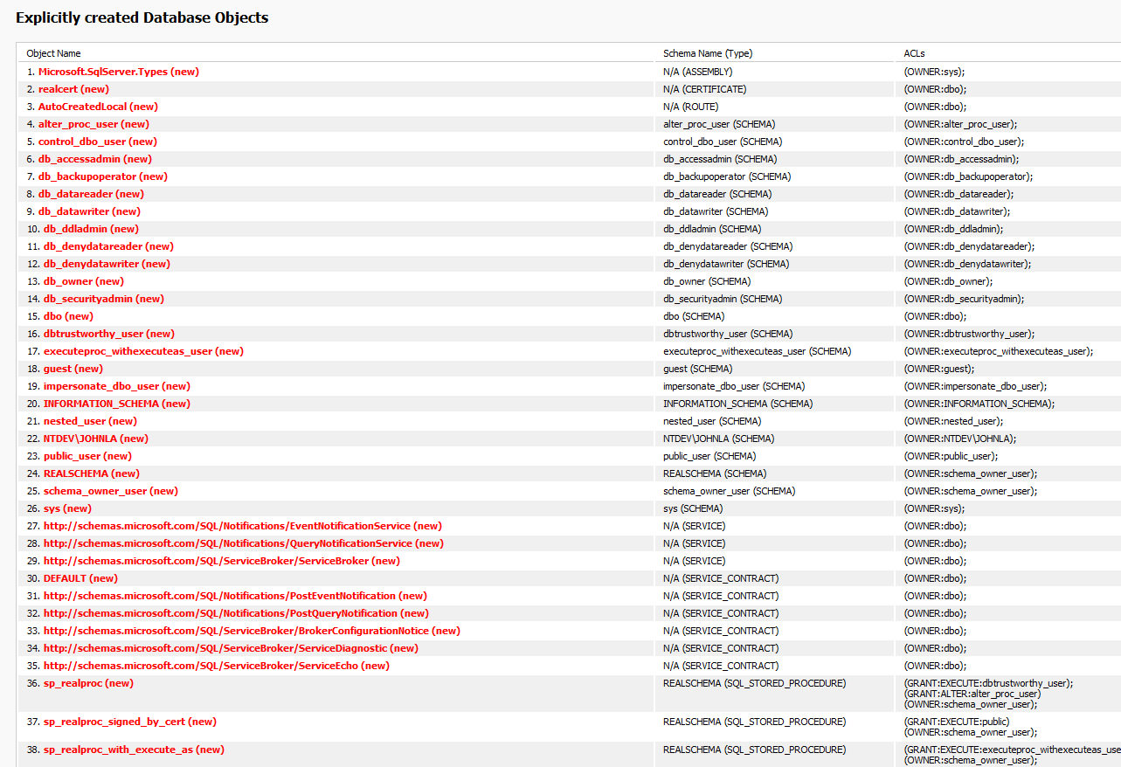
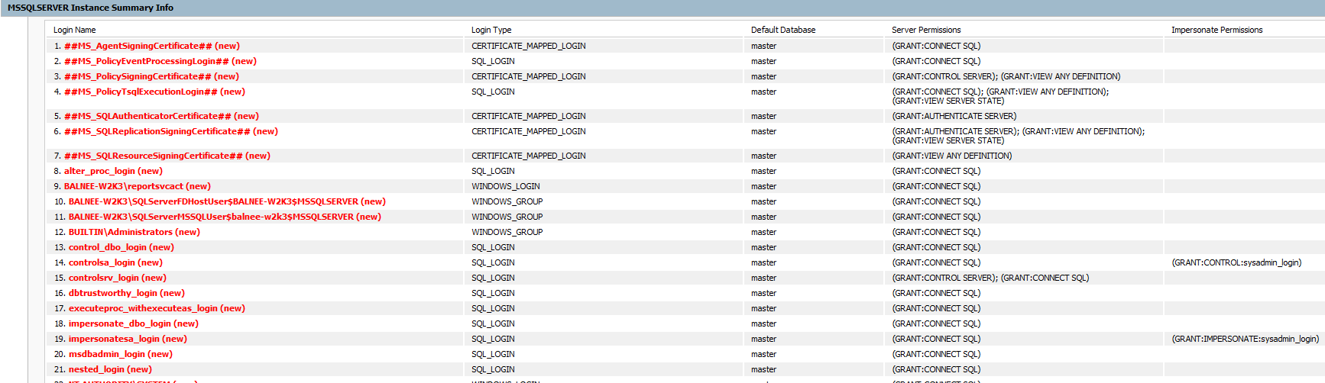
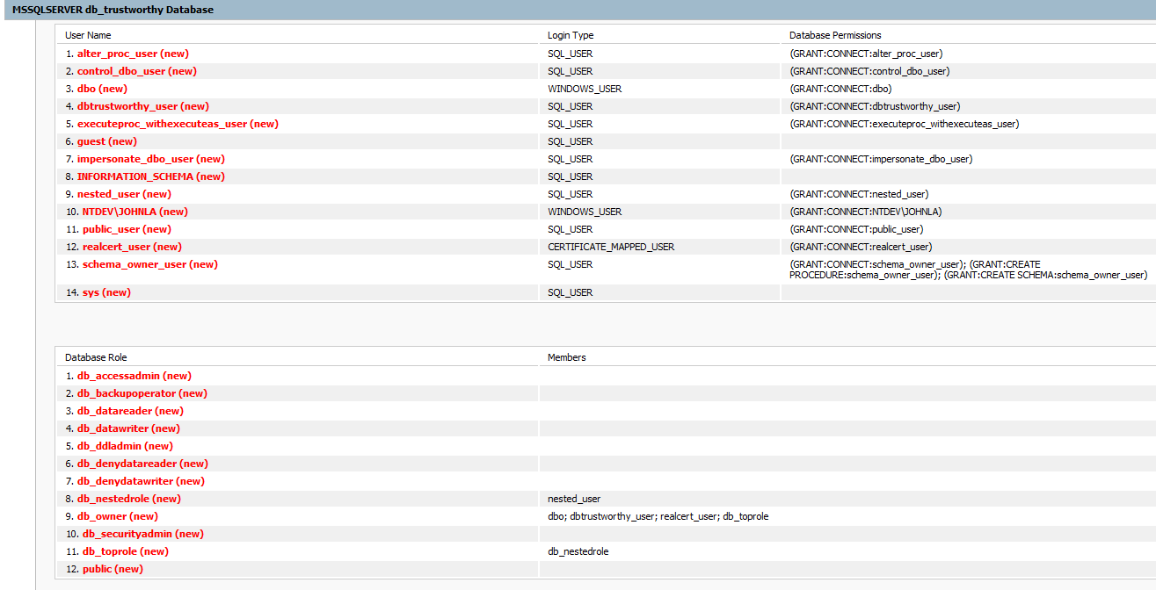
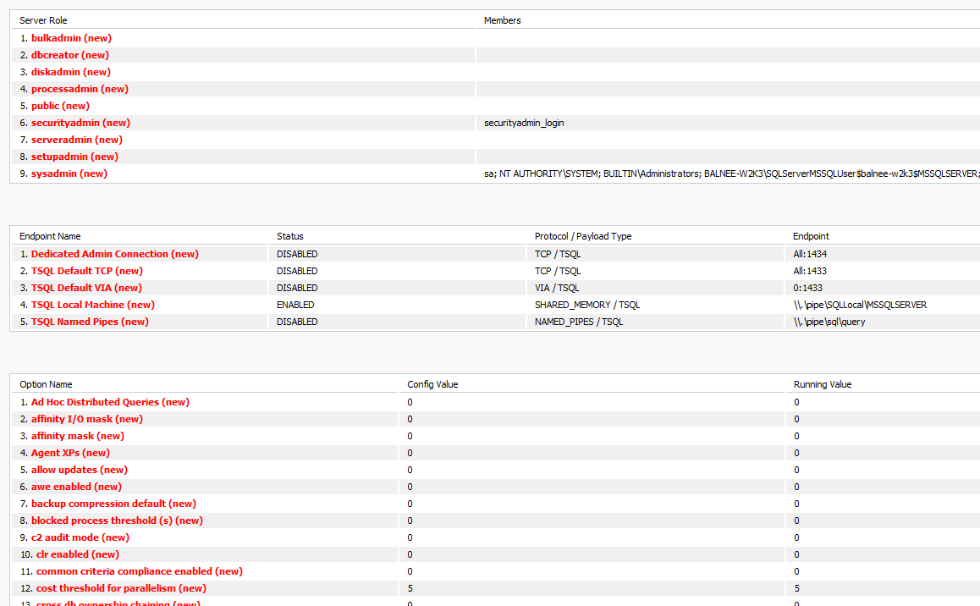
After
Database users and roles
Logins
SQL objects
Roles, endpoints
settings

Slide 18
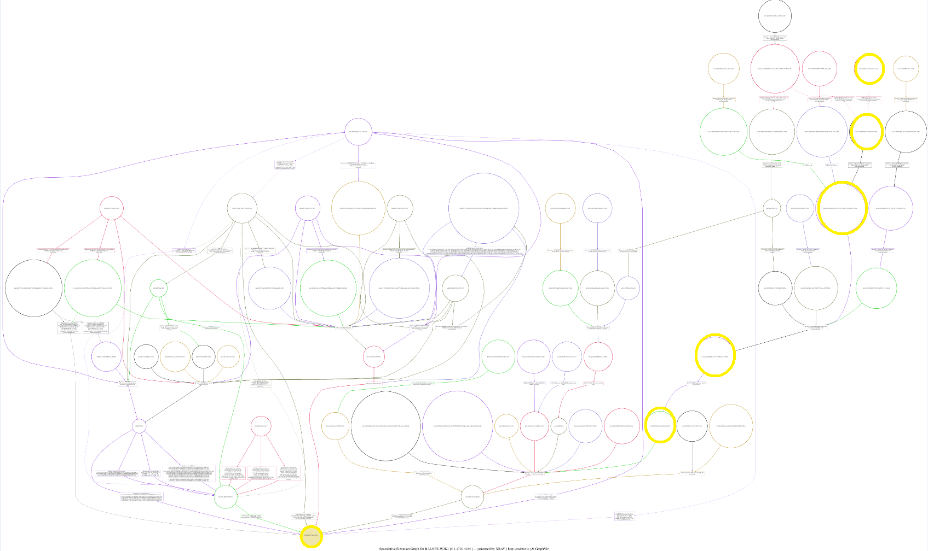
Additional elevations paths added to the graph

Slide 19
Who creates the graph?
You do
Security dependencies, Control relationships
New edges arise from:
0-days and unpatched vulns
Credential re-use
Logon patterns
Hacking in CS101 terms:
Attackers enter the graph
Network enumeration identifies the most valuable nodes
They dump credentials and navigate edges
Iterate until goal nodes reached
Lesson: beware of “list thinking”

Slide 20

Bluehat 2018 Graphs For Security Workshop
Welcome by Ram Shankar Siva Kumar (Microsoft)
Opening Remarks by John Lambert (Microsoft)
Graph platform - Leo Meyerovich (Graphistry)
StreamWorks - Continuous Pattern Detection on Streaming data - Sutanay Choudhry (PNNL)
Break
Cygraph - Steven Noel (MITRE)
Threat Intelligence Curation and Counterfactual Reasoning - Andrew Wicker (Microsoft)
Lunch
CloudMapper: AWS environment analysis and visualization - Scott Piper (Summit Route)
Graph based analysis in Azure Security - Yogesh Roy (Microsoft Azure)
Break
BloodHound - Rohan Varzakar and Andy Robbins (SpecterOps)
Graphs for Security - Luis Munoz Gonzalez
Break
Open Mic
Closing Remarks by John Lambert
We will make the presentations available afterwards

